Slide 1

New Ski Tours
Tolano Adventures
Notes:
New Ski Tours from Tolano Adventures

Slide 2
Agenda
Wapta Icefield Ski Traverse, Canada
Berner Oberland Ski Tour, Switzerland
La Vanoise Ski Tour, France
Haute Route, Switzerland
Monte Rosa Ski Tour, Switzerland
Notes:
We’re excited to present 5 new ski tours: one in Canada and four in Europe.

Slide 3
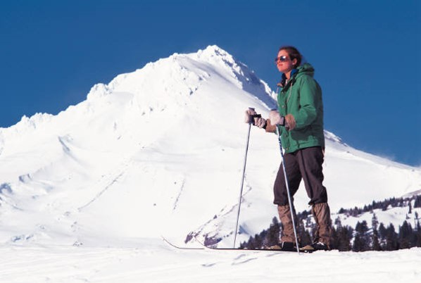
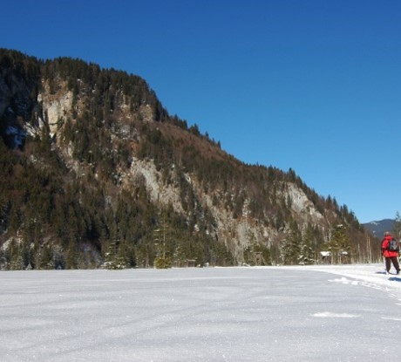
Hiking
Haute Route
Wapta Icefield Ski Traverse

Slide 4
Annual Snowfall
Notes:
And so is the snowfall.

Slide 5
Marketing and Promotion
Sales
Scheduling

Slide 6
List of the 10 most valuable brands
It’s not easy to create a valuable brand. The companies in the following list, which was created from a study of Brandirectory.com, are characterized by having some particular features:
Emotional connection
Sustainability
Financial leverage
Consumer loyalty
Current Rank | Previous Rank | Band | Country | Value in Millions of USD
1 | 1 | Apple | USA | 170,276
2 | 2 | Google | USA | 120,314
3 | 3 | Coca-Cola | USA | 78,423
4 | 5 | Microsoft | USA | 67,670
5 | 4 | IBM | USA | 65,095
6 | 8 | Toyota | JAPAN | 49,048
7 | 7 | Samsung Group | KOREA | 45,297
8 | 6 | General Electric | USA | 42,267
9 | 9 | McDonalds | USA | 39,809
10 | 15 | Amazon | USA | 37,948
11 | 11 | BMW | GERMANY | 37,212

Slide 7
Emotional Response
 | Health/Beauty | Automobile | Food/Drink
Humor | 20 | 10 | 25
Happiness | 80 | 25 | 60
Safety | 15 | 45 | 20
Family values | 50 | 20 | 35
Self-image | 50 | 5 | 71

